Slide 1
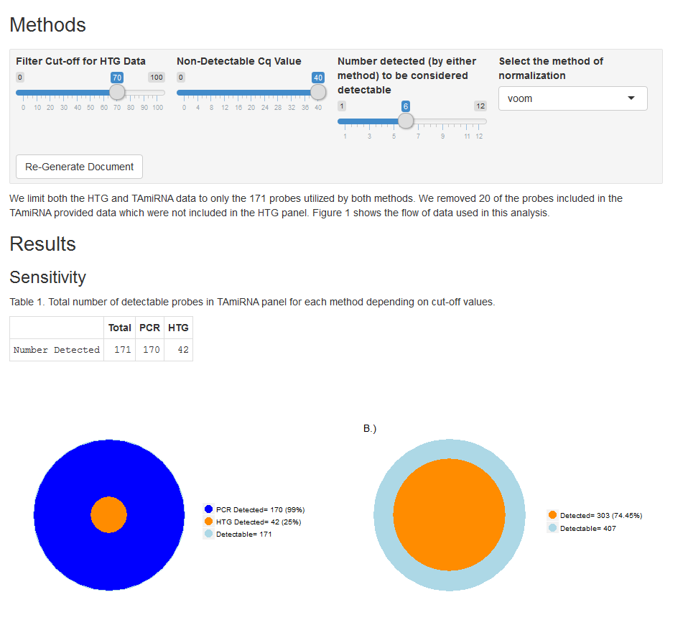
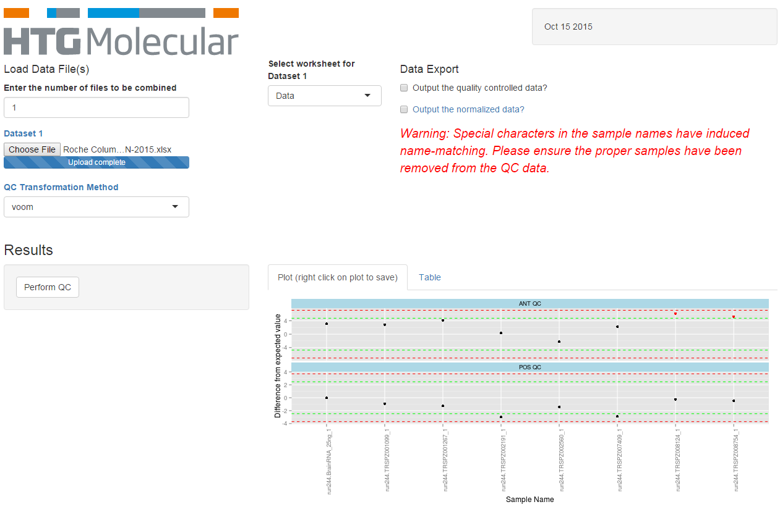
Interactive Tools and Documents

Slide 2
Introduction
Interactive documents and tools provide a valuable service to both internal and external customers
Interactive reports:
Provide a tool to both inform and educate
Allow users to ask and answer their own questions about the data and analysis
Interactive Tools:
Streamline repetitive analyses and reduce errors
Increase efficiency and reduce “gating”
Provide a high-value service to customers

Slide 3
Interactive Reports
Use R + “shiny” package + Rmarkdown language to create an HTML document viewable by any browser.
Customizable formatting
Can be hosted from a server or viewed locally
Easily converted to a static report in a variety of formats

Slide 4
Interactive Tools
Interactive web-page that runs R in the background
Can be hosted locally and run behind a firewall for internal clients
Enables scientists to get immediate results
Enforce best practices and ensure consistency
Or provided to external clients as an additional service
Easy way to provide statistical support for basic analyses without excess time commitment
Can use 3rd-party hosting service

Slide 5
Examples
TAmiRNA Report
QC App

Slide 6
server.R
Output
Input
ui.R
End User

